Slide 1


Slide 2
Sunny Bank Primary School Vision
Every child irrespective of background or starting point deserves to be happy, healthy and successful. At Sunny Bank Primary School, we are passionate about fostering children’s innate curiosity and their thirst for knowledge. Every child at Sunny Bank will see themselves as life - long learners acquiring the skills that they need to fulfil this.
Every staff member is focused towards the goal that, before they leave us for the next stage on their journey, EVERY CHILD will achieve the following: They will:
Become life-long learners. All will maintain their natural and constant curiosity. Have the skills to learn. Know where to start. Have the discipline for regular practice. Be self-aware and be able to reflect on their learning.
Become fluent readers. All will be able to read at their age expected standard.
Have a love of reading. All will see reading as opening a world of possibilities. A place to find pleasure and knowledge.
Become confident mathematicians. All will be fluent with their timestables, have mathematical dexterity and be able to tackle problems at their age expected standards.
Become confident writers. All will have an extensive vocabulary and a command of grammar that will allow them to communicate through writing at an age expected standard.
Enjoy learning new knowledge and acquiring new skills. Understand that each subject has its own disciplinary knowledge and substantive knowledge and will want to learn and practice these, taking pride in their academic achievements.
Seek out new challenges and new ways of thinking. All will have a hunger for new experiences, be confident and resilient in the face of challenges.
Be happy. All will be able to find positives in all situations, be able to self-regulate and be resilient in the face of adversity.
Be kind. All will value the joy that can be experienced by helping others and bringing happiness to others.
Thrive on becoming better friends and making new friends. All will understand the value of building better relationships for their own and everyone’s success and happiness.
Learn to ride a bike, learn to swim and learn how to play an instrument. We believe that these are fundamental opportunities that all children should have access to.
At Sunny Bank Primary School, we understand that all children are individuals and that some children have complex needs which take many forms. At Sunny Bank we aspire to providing an education system that is ambitious, meet their individual needs and flexible enough to enable all of our children to overcome those barriers and be The Best That They Can Be.

Slide 3
Reading Outcomes at SB
Phonics outcomes – 23-23
  63% at expected outcomes
  National 67%
  this cohort had much higher than national SEND
Year 6 Outcomes 22 – 23
  81% at expected outcomes
  National 73%
  48% at the higher standard - well above national 2022 28%
Reading School
  Pupil survey – children love reading
  Library is full at lunchtime with children choosing to come into the library
  Children constantly talking about books to teachers
  Teachers seen as readers
  Competitions

Slide 4


Slide 5

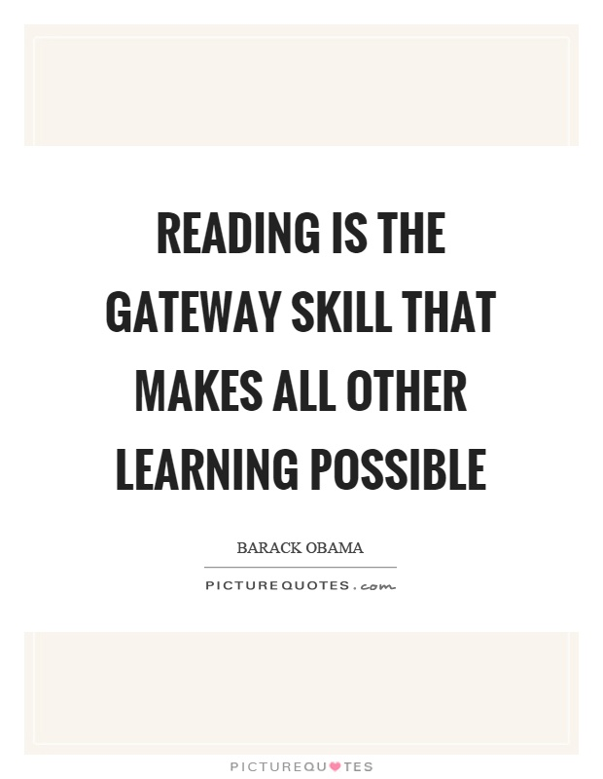
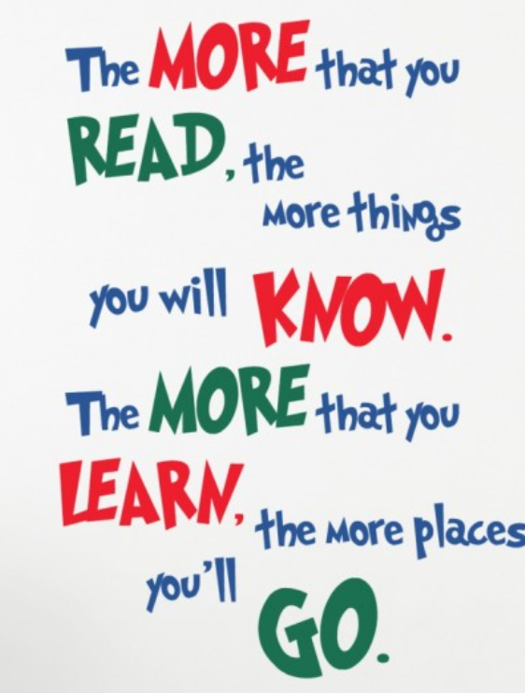
Importance of reading
Notes:
Reading is necessary to learn well –in every other subject. The biggest impact and the most powerful way parents can support children’s learning is encouraging them to read at home.
Children need vocabulary to learn. The more words that children know the better they will learn. Children who read have a more extensive vocabulary and learn in all subjects better.
When children have a love of reading, they enjoy reading, and are happy. They really can explore the world real and imagined, expand their imaginations and therefore their creativity, which is so vital in the ever changing world that they will grow into.

Slide 6
Reading curriculum at SB
Love of reading
  Staff and parents as readers
  Book talk
  Library – request and reserve books, and suggest books for our library
  Face book
Home reading
  30 minutes daily
  Accelerated reader
  Share stories daily at home
Phonics
  The importance of early reading
  How it works and how you can support at home
Reading after phonics
  How we teach reading post phonics

Slide 7
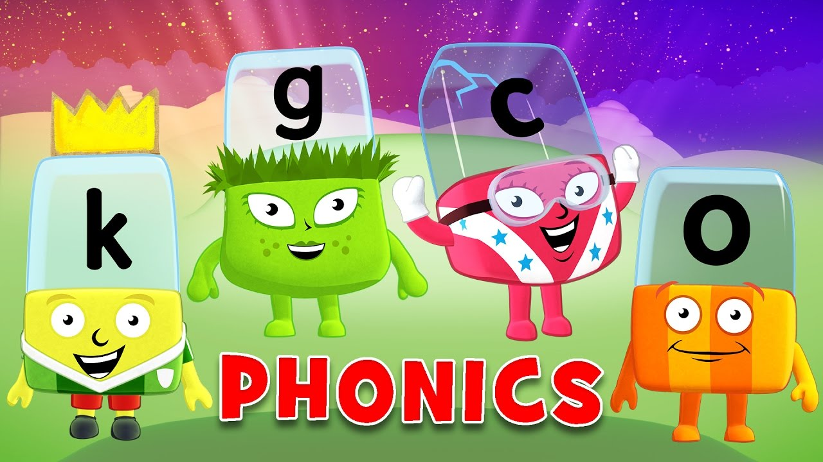

Slide 8
What is phonics?
Phonics is the relationship between letters and sounds.
For example, in the Foundation Stage your child may learn ‘d’ as
in dog. In Y1, they may learn ‘ear’ as in fear.
All readers use a range of strategies and we aim to develop all
of these. However, research has shown that the most able
readers pay attention to every word in a sentence.
This requires competency in phonics.
We teach regular, discrete, explicit and systematic phonics lessons.
At all times, we aim to make phonic lessons fun and interactive
by using a range of strategies and resources.

Slide 9
6 phase teaching programme
Progression
Foundation Stage: Phases 1 – 3
Year One : Phases 4 & 5
Year Two: Phase 6

Slide 10

Introduction to Monster Phonics - YouTube

Slide 11
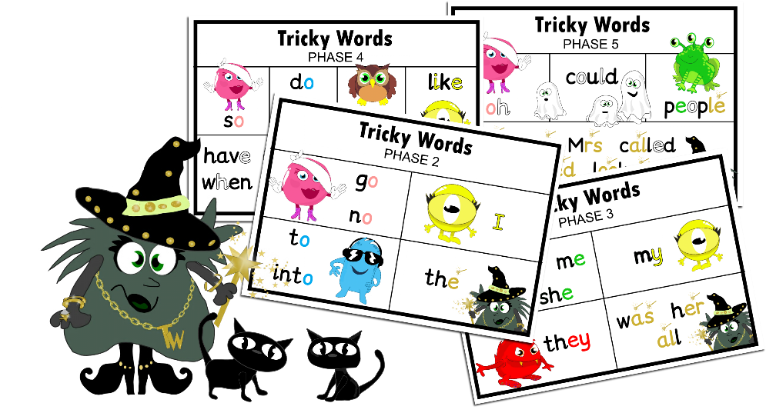
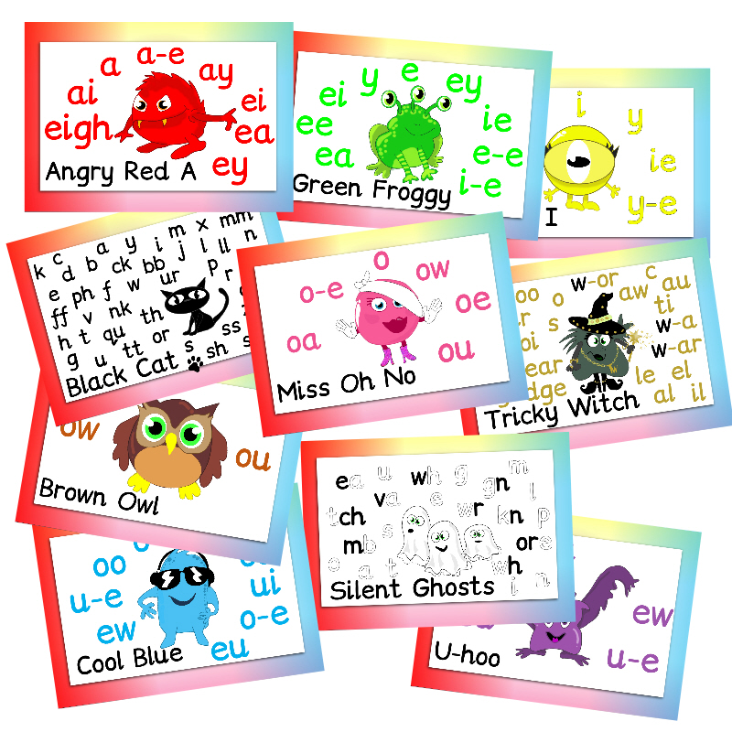
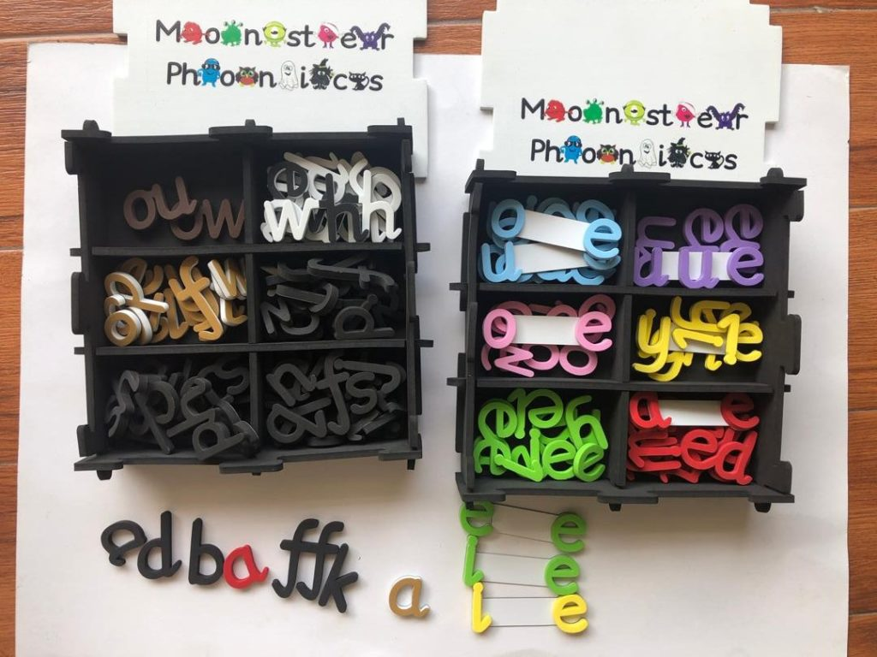
Resources…

Slide 12
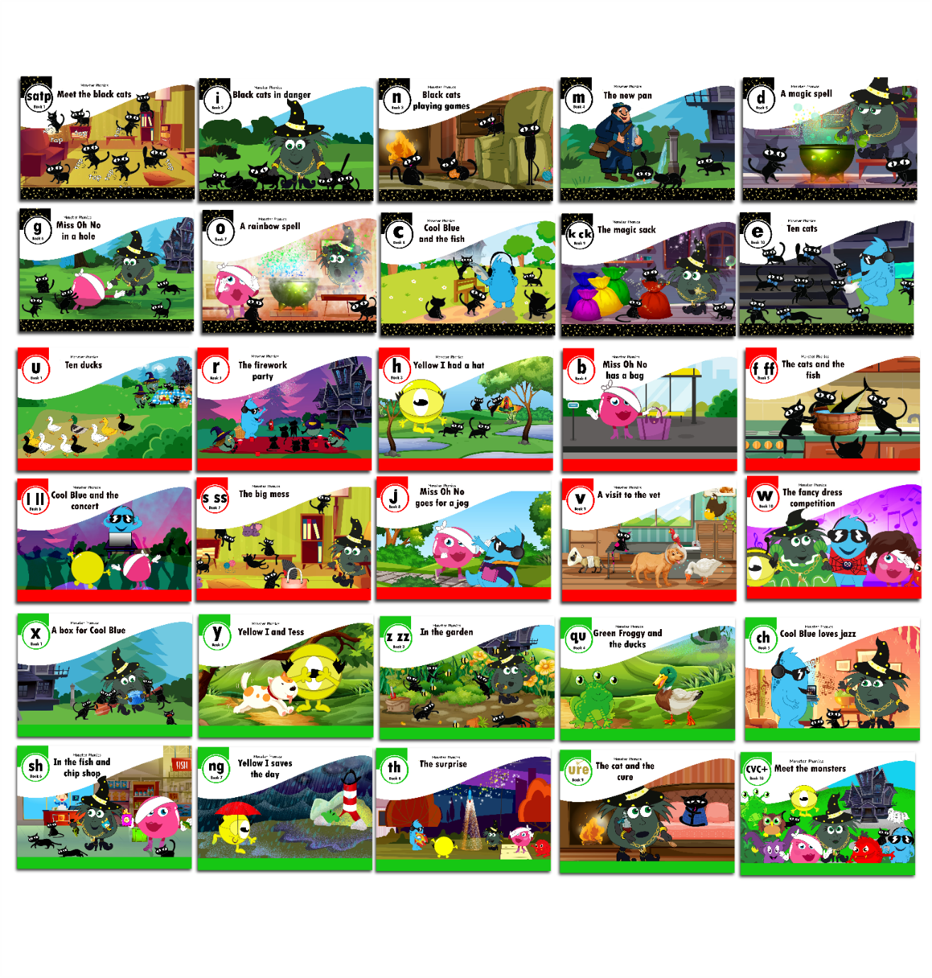
E – books/ reading scheme…
Please use the following like to sign up to the website to access the e-books.
https://monsterphonics.com/register/ebooks-whole-scheme/?ca=5eb8ef1ed0966075e5f5944a6ae78a81

Slide 13
What can you do to help?
Read daily with your child
Use flashcards to practise less secure sounds
Encourage your child to blend sounds
when tackling unfamiliar words
Model correct articulation of sounds
Enjoy reading!

Slide 14
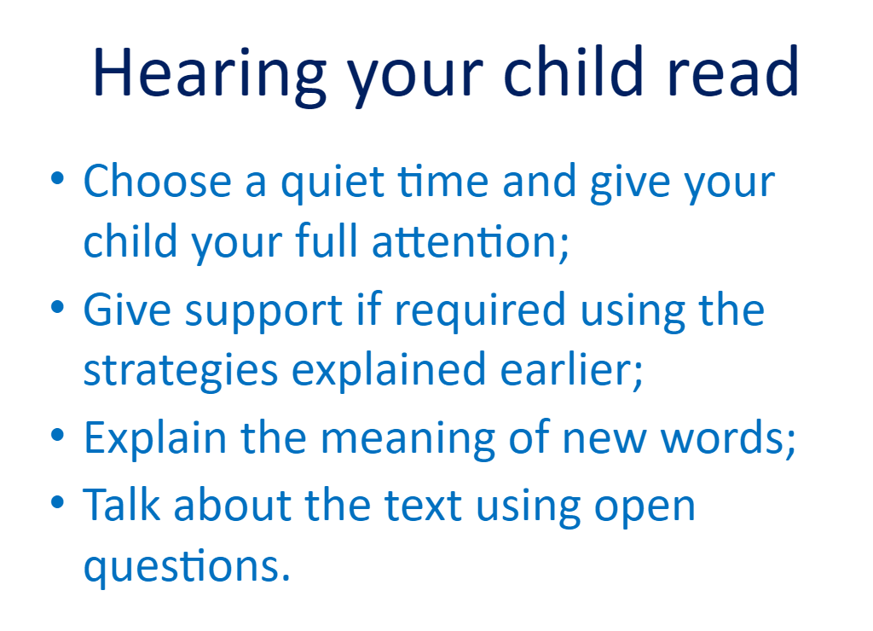

Slide 15

'We know that children learn best when parents and teachers follow the same methods.'

Slide 16
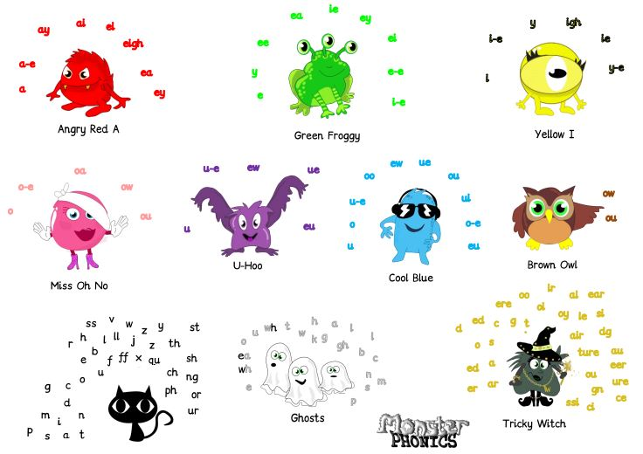
Monster Phonics uses the 10 monsters to categorises all sounds into 10 simple areas. Furthermore, each monster has a different colour and that colour represents that way of spelling the sound.

Slide 17
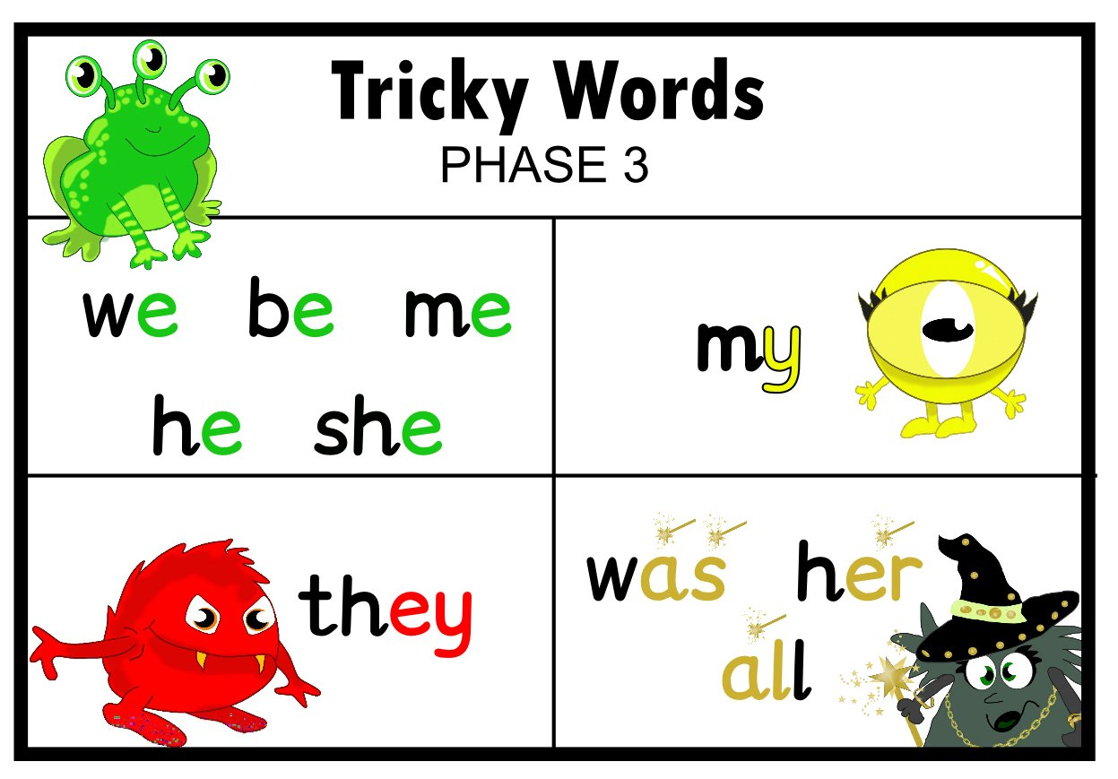
Monster Phonics makes learning fun and more memorable. Rather than relying on rote learning, Monster Phonics uses colour-coding to promote understanding, which leads to children becoming confident, independent learners.

Slide 18


Slide 19
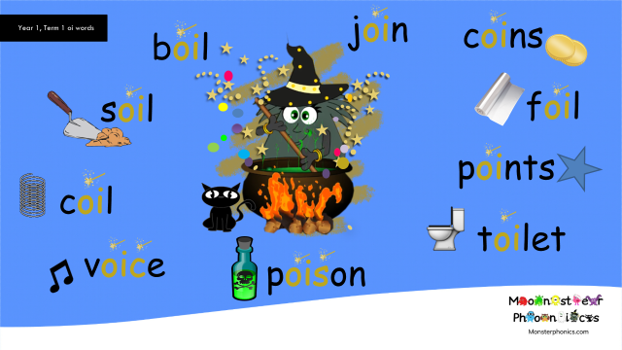

Slide 20


Slide 21
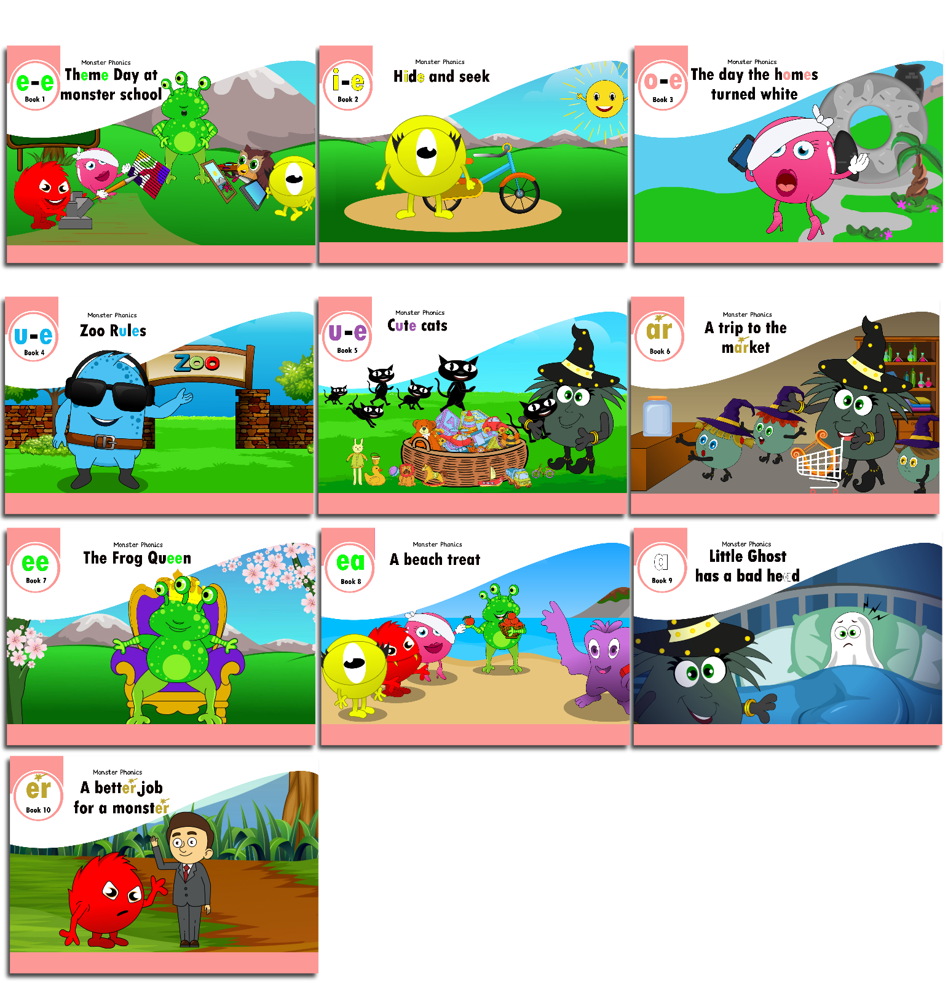

Our brand new
Monster Phonics
Books...

Slide 22

Reading expectation.

Slide 23

for books not returned - contribution
HELP US TAKE CARE OF OUR NEW BOOKS!
£3.00

Slide 24
Reading past phonics

Slide 25
Reading lessons ks2 – ready steady comprehension
A whole class, shared reading approach which provides a clear, progressive teaching sequence.
Each lesson has read, model, practise and apply.
Strong vocabulary focus
Exciting texts which link across the curriculum
Model lesson

Slide 26
Thursday 14th September 2023
WALT: understand how the author uses language to make magic and mystery.
WILF:
Read closely, annotating for specific purposes
• Connect prior knowledge and textual information to make inferences and predictions

Slide 27
Prior knowledge
Lets look at the front cover and inside page of the book.
What does emporium mean?
Notes:
Emporium - a store offering a wide variety of goods).

Slide 28
Anchor Question
A) How does the author create a sense of magic and mystery in the prologue?
B) How does this influence what happens in the story?

Slide 29
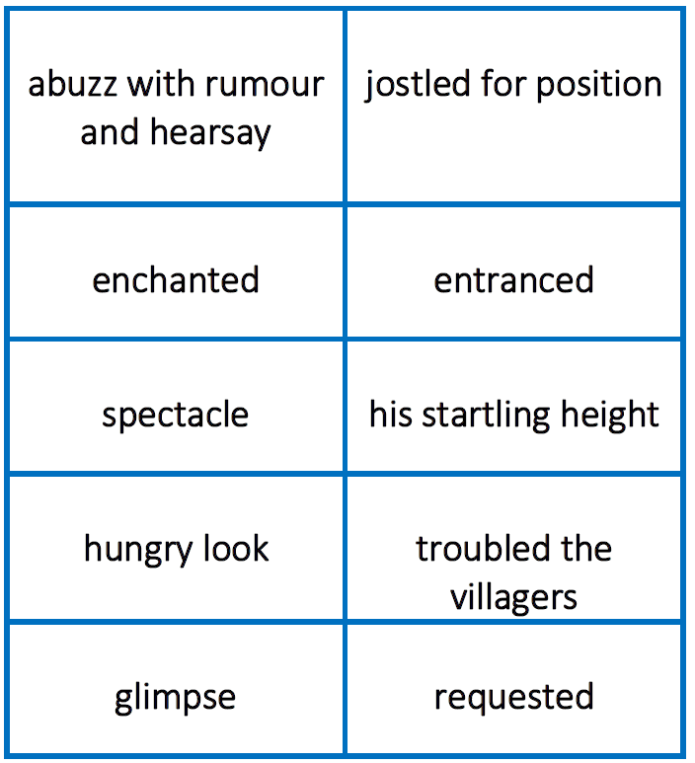
Vocabulary
Anchor question(s): A) How does the author create a sense of magic and mystery in the prologue?
B) How does this influence what happens in the story?

Slide 30
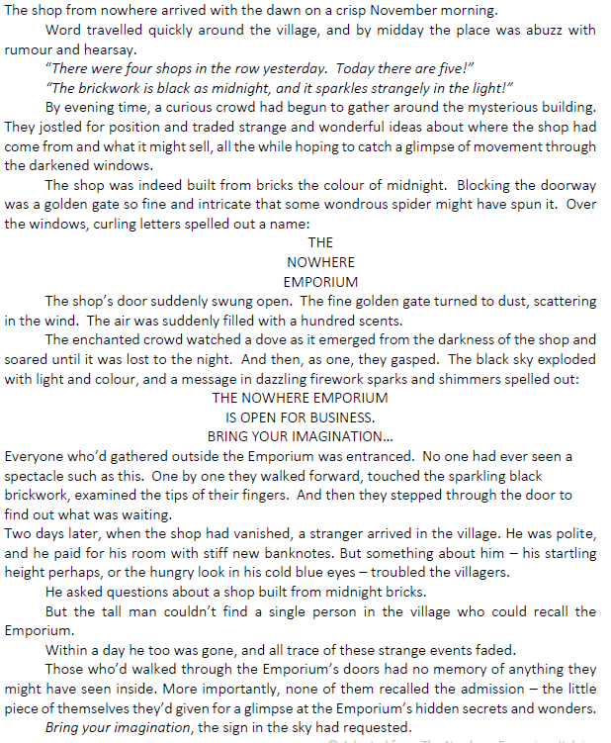
Anchor question(s): A) How does the author create a sense of magic and mystery in the prologue?
B) How does this influence what happens in the story?

Slide 31
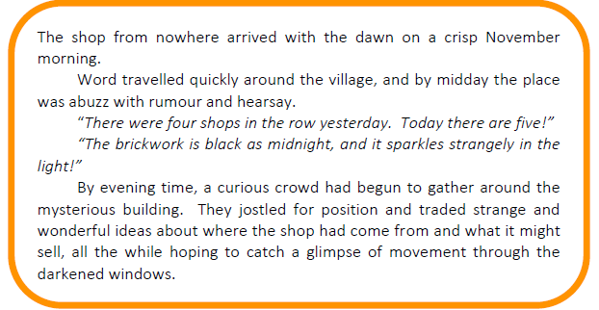
Anchor question(s): A) How does the author create a sense of magic and mystery in the prologue?
B) How does this influence what happens in the story?
Notes:
ency, modelling expression.

Slide 32
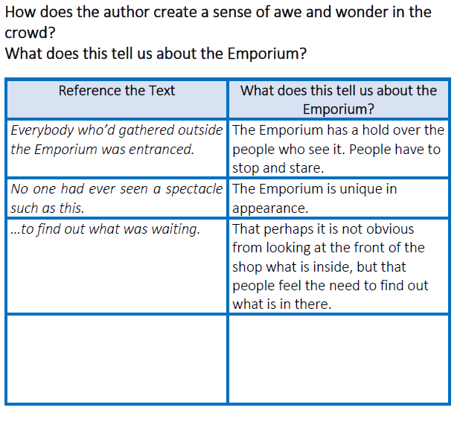
Anchor question(s): A) How does the author create a sense of magic and mystery in the prologue?
B) How does this influence what happens in the story?
Teacher model – text mark evidence to answer anchor question A.
Notes:
Teacher note: Make it clear to the children that their predictions and inferences are always linked to textual evidence.
Reference the Text: Text Mark the following significant words and phrases that help us make inferences and predictions about this: ‘entranced’, ‘No one had ever seen a spectacle such as this’, ‘examined the tips of their fingers’, ‘to find out what was waiting’. Model Text Marking the evidence and underlining new vocabulary. Think Aloud as you consider the evidence. Complete the Lesson 1: Teacher Model, demonstrating Inference and Prediction.

Slide 33
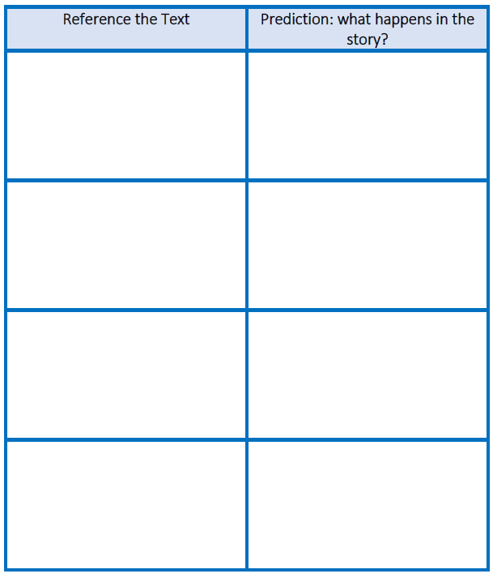
Anchor question(s): A) How does the author create a sense of magic and mystery in the prologue?
B) How does this influence what happens in the story?
Your turn – text mark parts of the text that create magic and mystery and use this to predict what might happen in the story.
Notes:
If children are struggling to find evidence, consider ‘the shop from nowhere arrived’, ‘place was abuzz with rumour and hearsay’, ‘curious crowd…mysterious building’, ‘sparkles strangely in the light’, ‘darkened windows’, fine gold gate turned to dust’, ‘watched a dove as it emerged’, ‘message in dazzling firework sparks and shimmers’, ‘the shop had vanished’, ‘a stranger arrived’,’ all trace of these strange events faded’, ‘couldn’t find a single person who…’, ‘had no memory of anything’ etc. What does this tell us, and what predictions could we make about the story? Teacher to feedback.
Acceptable Point(s) Anchor Question A:
• any reference to the shop appearing from nowhere and vanishing just as easily
• raised curiosity in the town people – considered it to be a mysterious building
• unusual happenings – the gate turns to dust – fireworks spell out the shop’s name etc.
• the darkened windows provide a sense of mystery
• dove detail hints at magic
Acceptable Point(s) Anchor Question B:
• we will find out more about the Emporium – it may turn up in a different town
• may find out why people don’t remember it once it has moved on
• find out more about the unfriendly man – why he wants to know about the Emporium

Slide 34
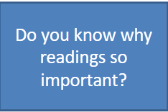
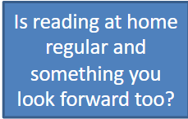

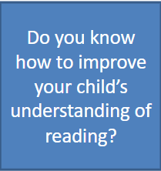
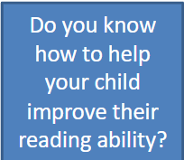
Some questions to think about

Slide 35
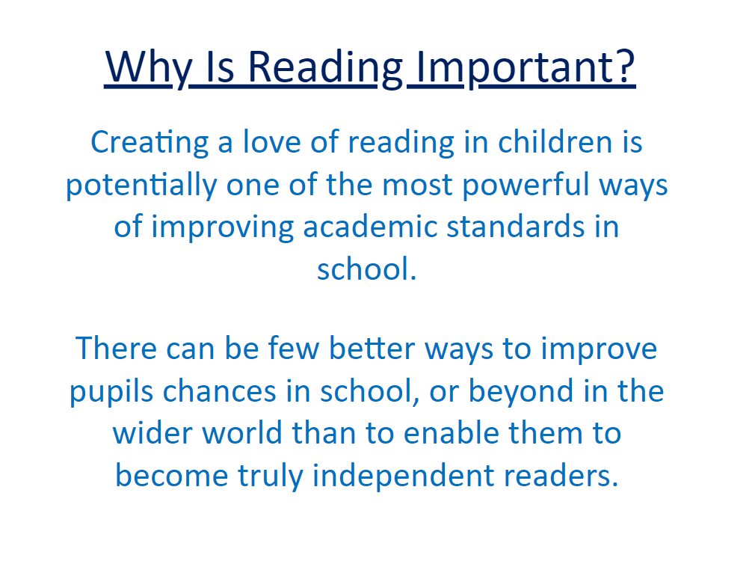

Slide 36
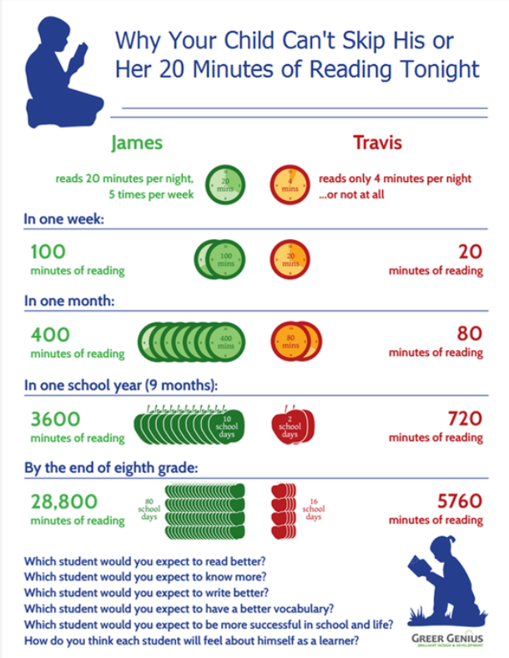

Slide 37
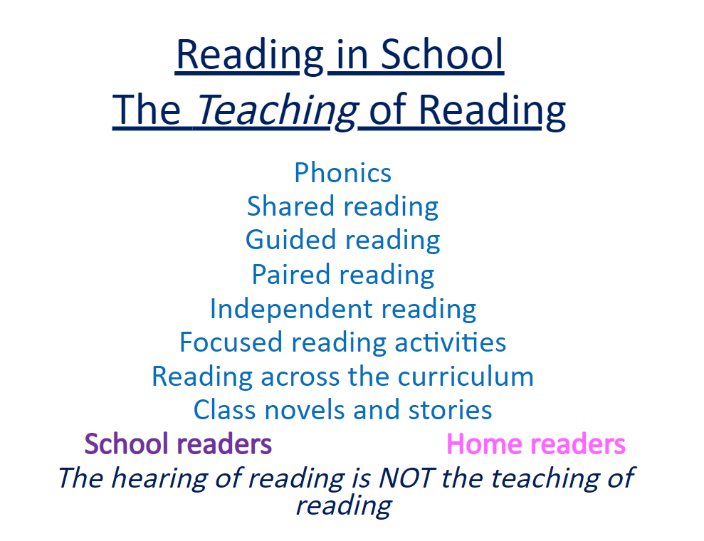

Slide 38
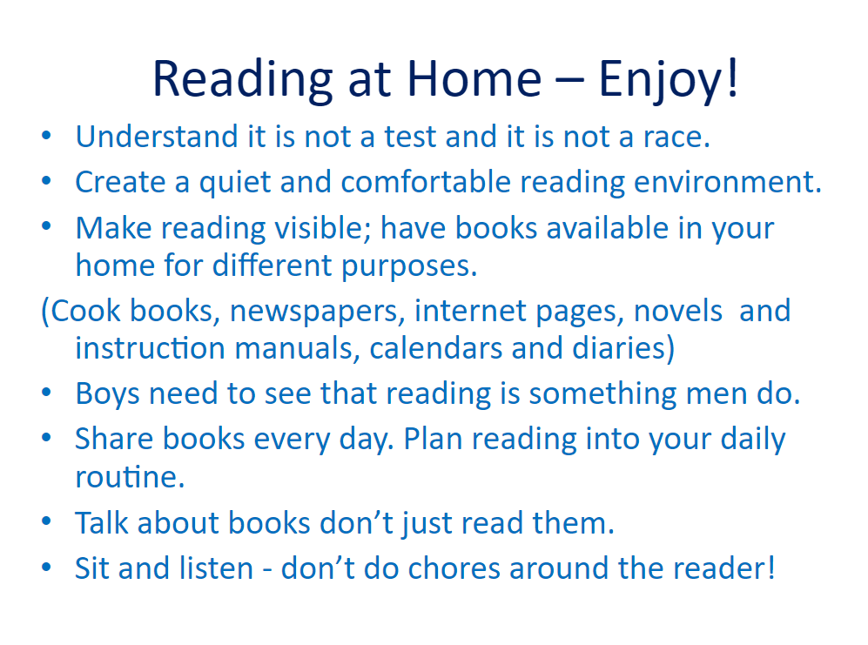

Slide 39
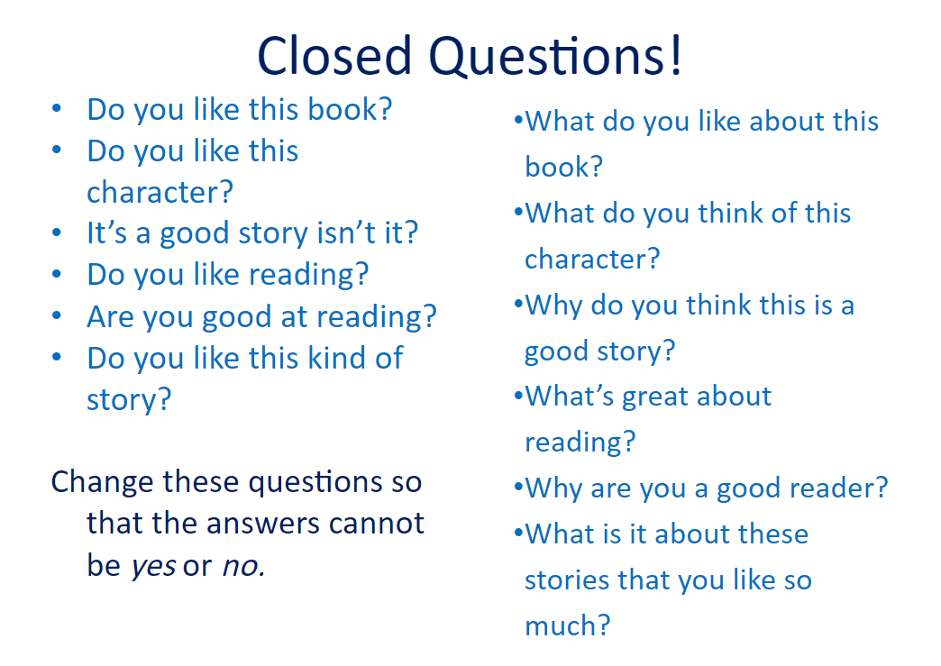

Slide 40
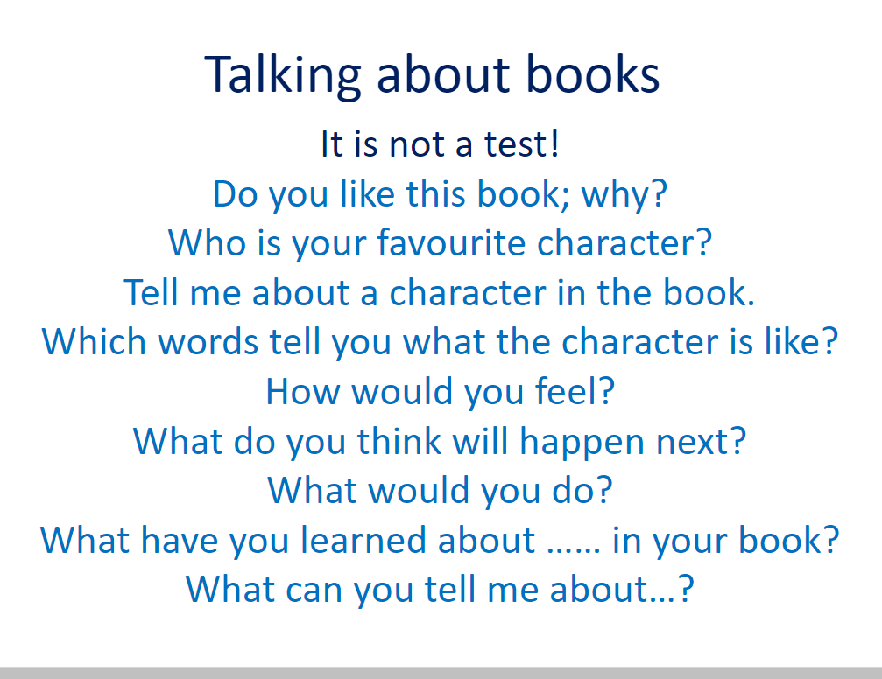

Slide 41
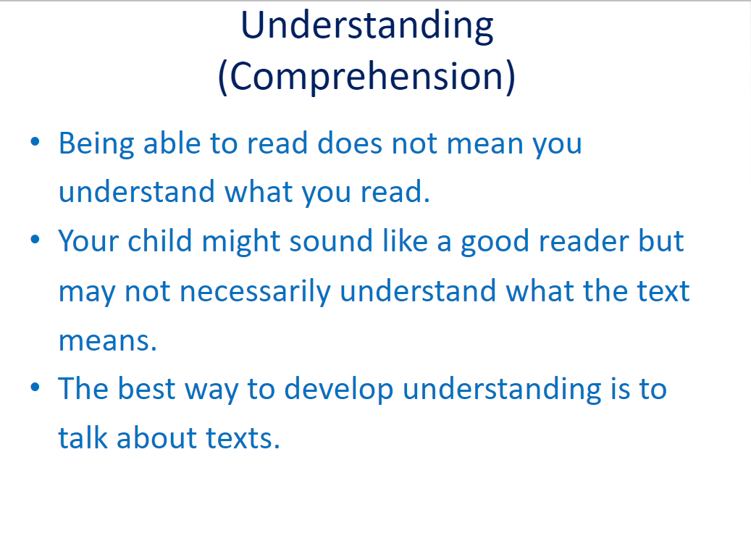

Slide 43
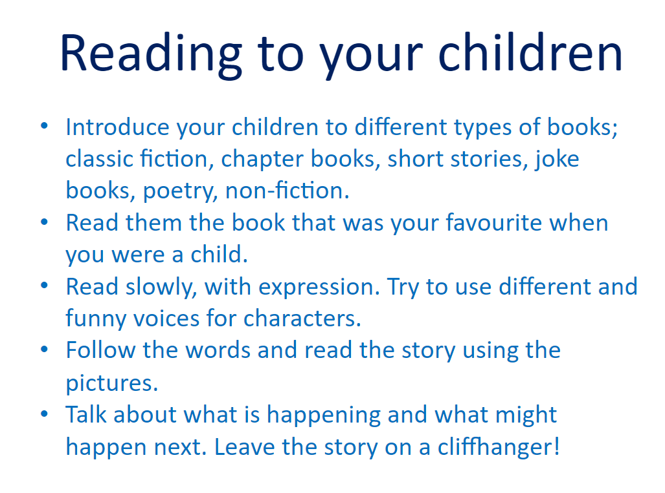

Slide 44
Key stages
Phonics – All children in y1 have to take the phonics screener
  Pass mark usually 32 out of a possible 40
  Pass or not pass judgement
Ks1
  KS1 SATs – all children take a reading test at the end of Year 2 and based upon this is the teacher makes an assessment.
  Children need to make 100 scaled score to be at expected age
  The number of marks to reach a SS 100 is against a benchmark based on the scores of children nationally
  Reading fluency and comprehension is tested
KS2
  all children take a reading test at the end of Year 6
  Children need to make 100 scaled score to be at expected age – no teacher assessment
  The number of marks to reach a SS 100 is against a benchmark based on the scores of children nationally
  Reading fluency and comprehension is tested

