Slide 1
Forsters School Outfitters
How to order your School Uniform

Slide 2
Shop Online at www.forsterskent.co.uk or visit us in store
FREE Click & Collect is available on all online purchases
Home delivery is available for £4.99
You can also visit us in store
For larger purchases please book an appointment on our website as this reduces your waiting time during the busy July to August back to school period

Slide 3
How to Order Online
Visit our website www.forsterskent.co.uk
Click on the “Find your School” image on our Homepage
Click on Sunny Bank Primary School
Once you have Finalised your purchase select your Delivery Option
You can select Free Collection from Sittingbourne Store or our Sheerness store, or Home Delivery for £4.99

Slide 4
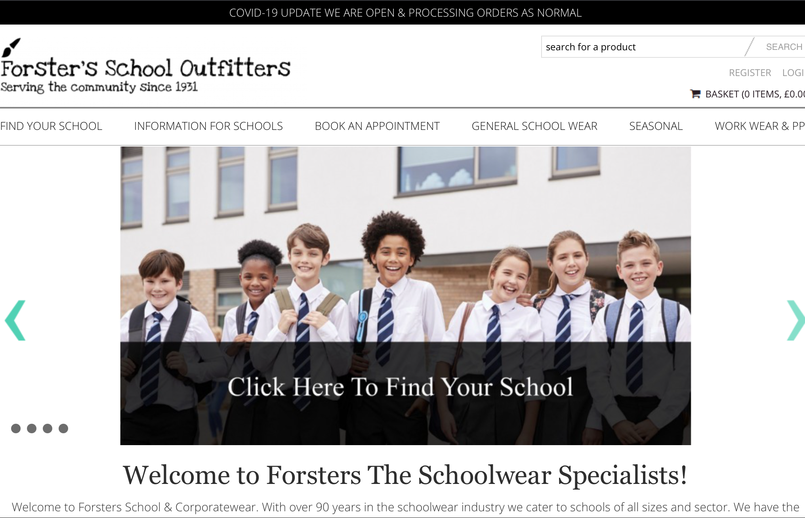
A Quick Guide to our website
Step 1 - Find your school by clicking on the image below

Slide 5
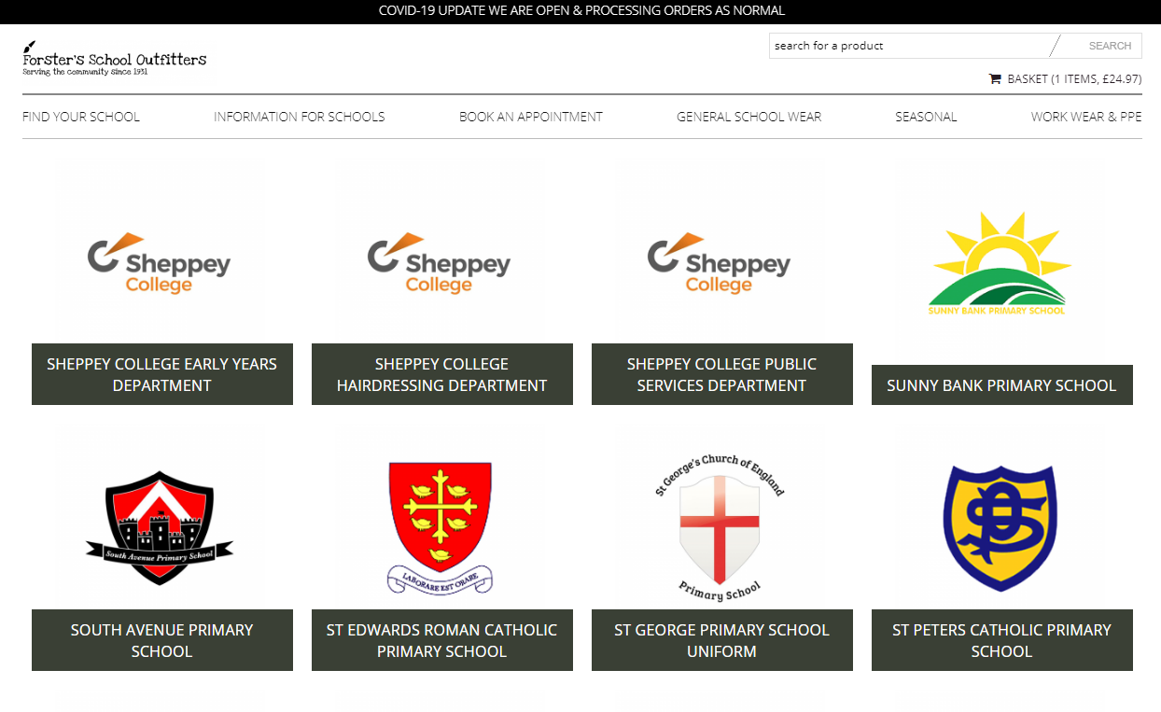
Step 2 - Select your school
Select the link for Sunny Bank Primary School, from there you will able to browse the full range of uniform.

Slide 6
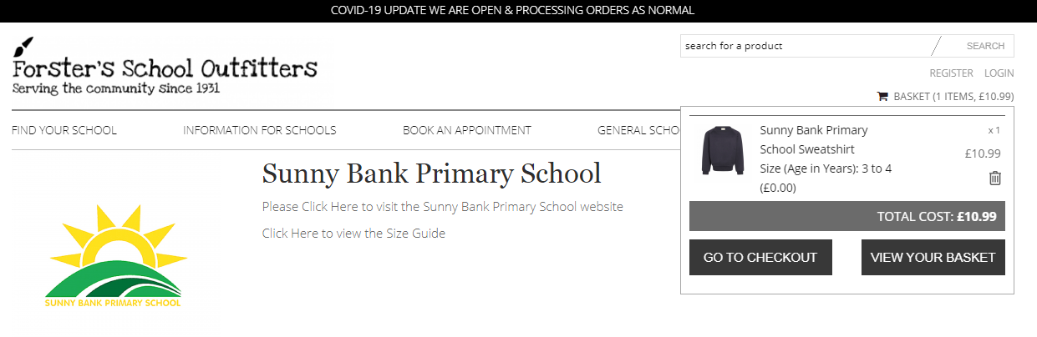
Step 3 Checkout
Once the uniform you require has been selected, you will need to checkout to complete your order
To check out, please click “basket” in the top right of your screen.

Slide 7
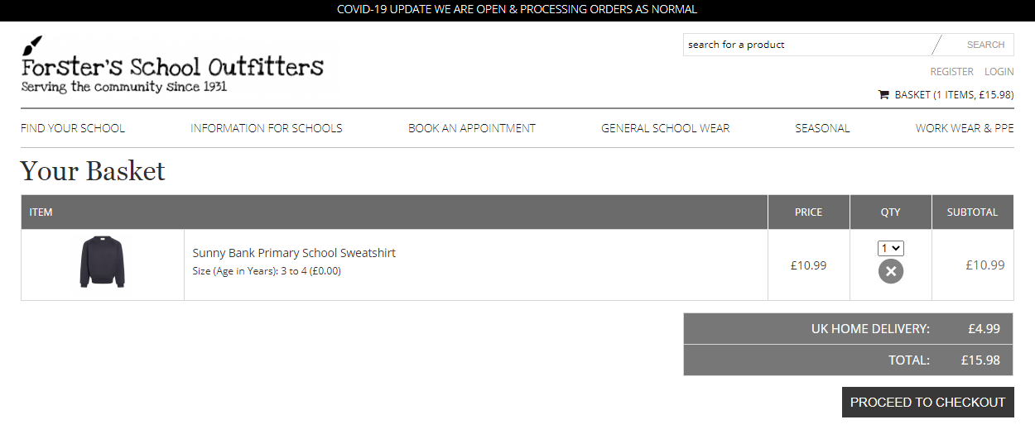

Step 3 Checkout
Then click “proceed to checkout”

Slide 8
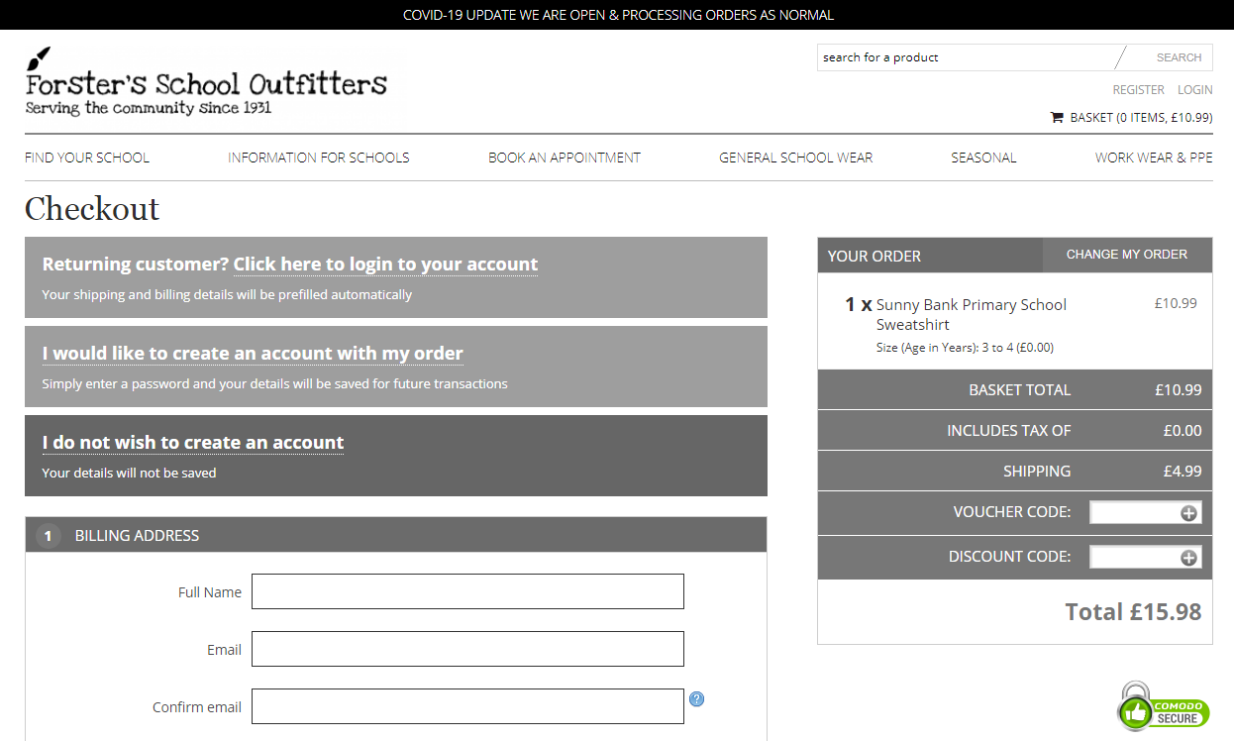
Step 3 Checkout
Please check out - you can keep a record of all your orders with us by creating your account in the checkout.
Please kindly make sure that you enter your email address correctly, you will be required to type it out twice to verify it

Slide 9
Booking an Appointment
Booking an appointment reduces your wait time by pre-booking a personal time slot
We will help you with sizing, so you can shop with confidence
We have taken all the steps necessary to make our stores Covid-19 secure
A personalised service from a trained and experienced member of our team
We strongly recommend booking your appointment during June or July for the best service, as during August we are extremely busy so you will likely encounter a longer wait, whereas appointments during June and July are very likely to go ahead at the scheduled time

Slide 10
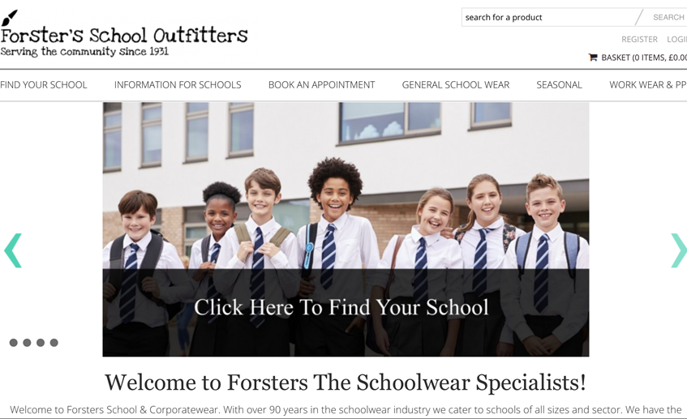
How to Book
Simply click on the link “Book an Appointment” on our homepage
Once on the page click the link titled “Book Appointment”
Select the relevant time and date on our “Booksy” page
This can be done from any smartphone

Slide 11
When to Order Uniform
We advise all parents to purchase uniform required for the September Term by Friday 30th of July
This will ensure stock is available and that any items which require ordering arrive in good time
If any uniform needs exchanging, we are extending our exchange policy until three weeks after school starts so simply visit us at any time to do this
August is the busiest month for all Uniform suppliers so we advise purchasing before then if it is possible
We will endeavour to fulfil all orders whenever they were placed, but please kindly note that during the month of August orders can take 14 working days

Slide 12
How to Find us
Forsters has two shops located at the Addresses below:
Forster’s School Outfitters (Sittingbourne Shop)
17-19 East Street
Sittingbourne
ME10 4BQ
Forster’s School Outfitters (Sheerness Shop)
16 High Street
Sheerness
ME12 1NL

Slide 13
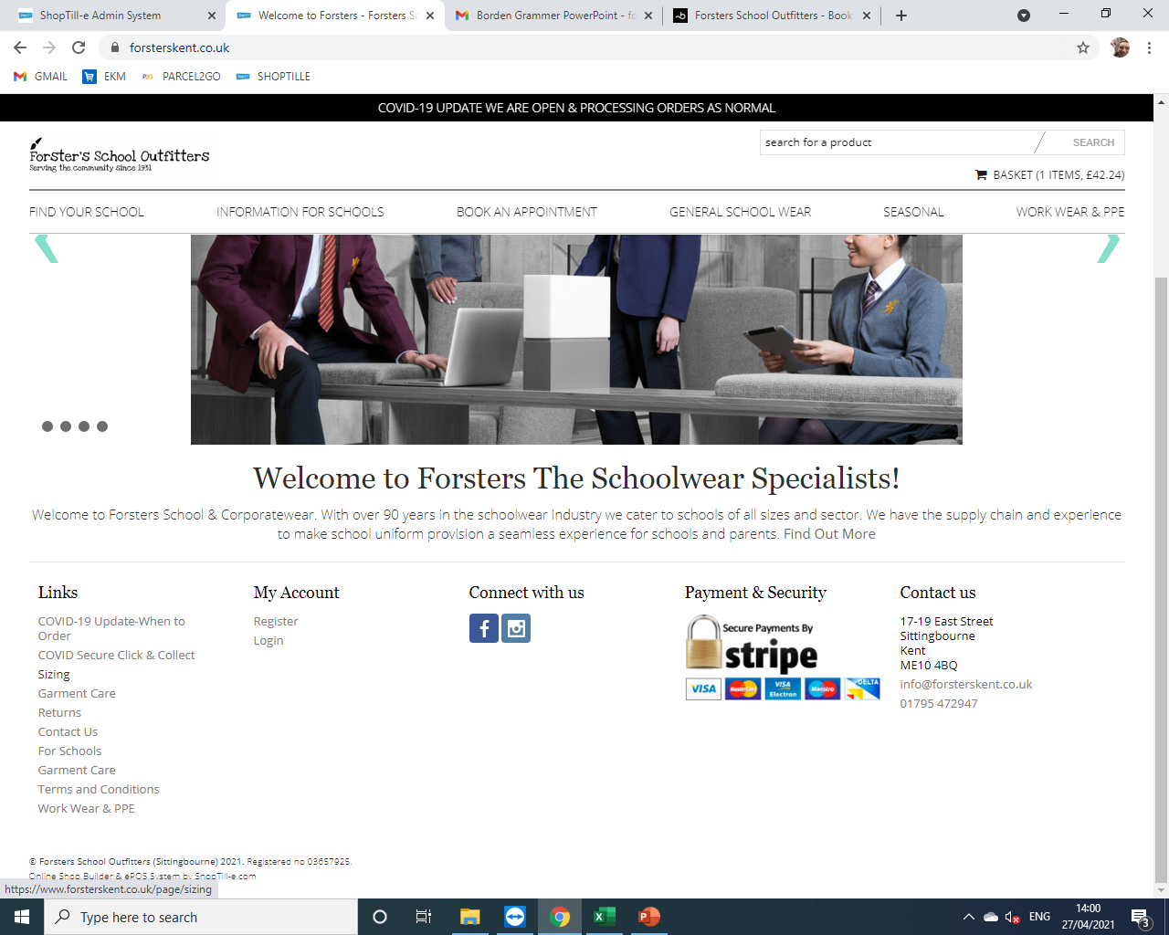
How to Measure your Child
We have a series of useful videos on our website demonstrating how to measure for different items of uniform
These can be found by following the link below:
https://www.forsterskent.co.uk/page/sizing
You can find this page by clicking on the link called “Sizing” on the homepage of our website www.forsterskent.co.uk

Slide 14
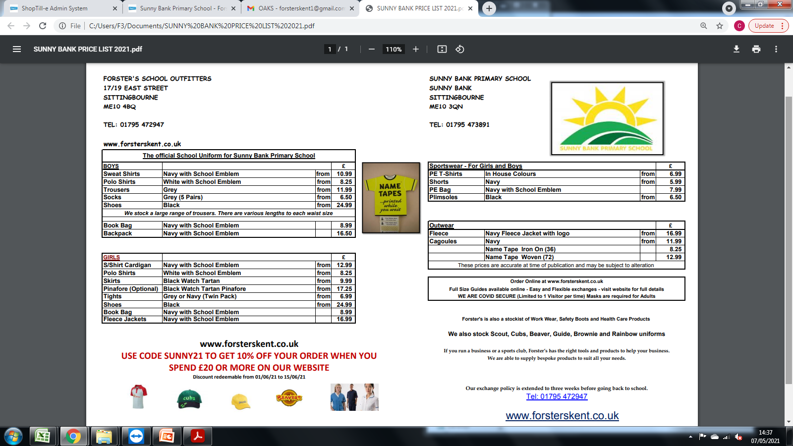
Uniform List

Slide 15

If you need any help…
If you have any further questions please contact us on the telephone numbers/email address below (Please kindly note that our phone lines are not always available during the month of August due to high demand)
Forsters Sittingbourne – 01795 472947 Monday to Saturday 9 am – 5:30 pm
Forsters Sheerness- 01795 665540 Monday to Saturday 9 am – 5 pm (excluding Wednesdays)
Email us at: info@forsterskent.co.uk

